Slide 1
Components inside a Computer Team 5
Thank you all for comming here today.

Slide 2

Members of our team
 | Đường Trường Dương
 | Đào Xuân Trường
 | Trần Đình Hoan
 | Đỗ Văn Hùng

Slide 3
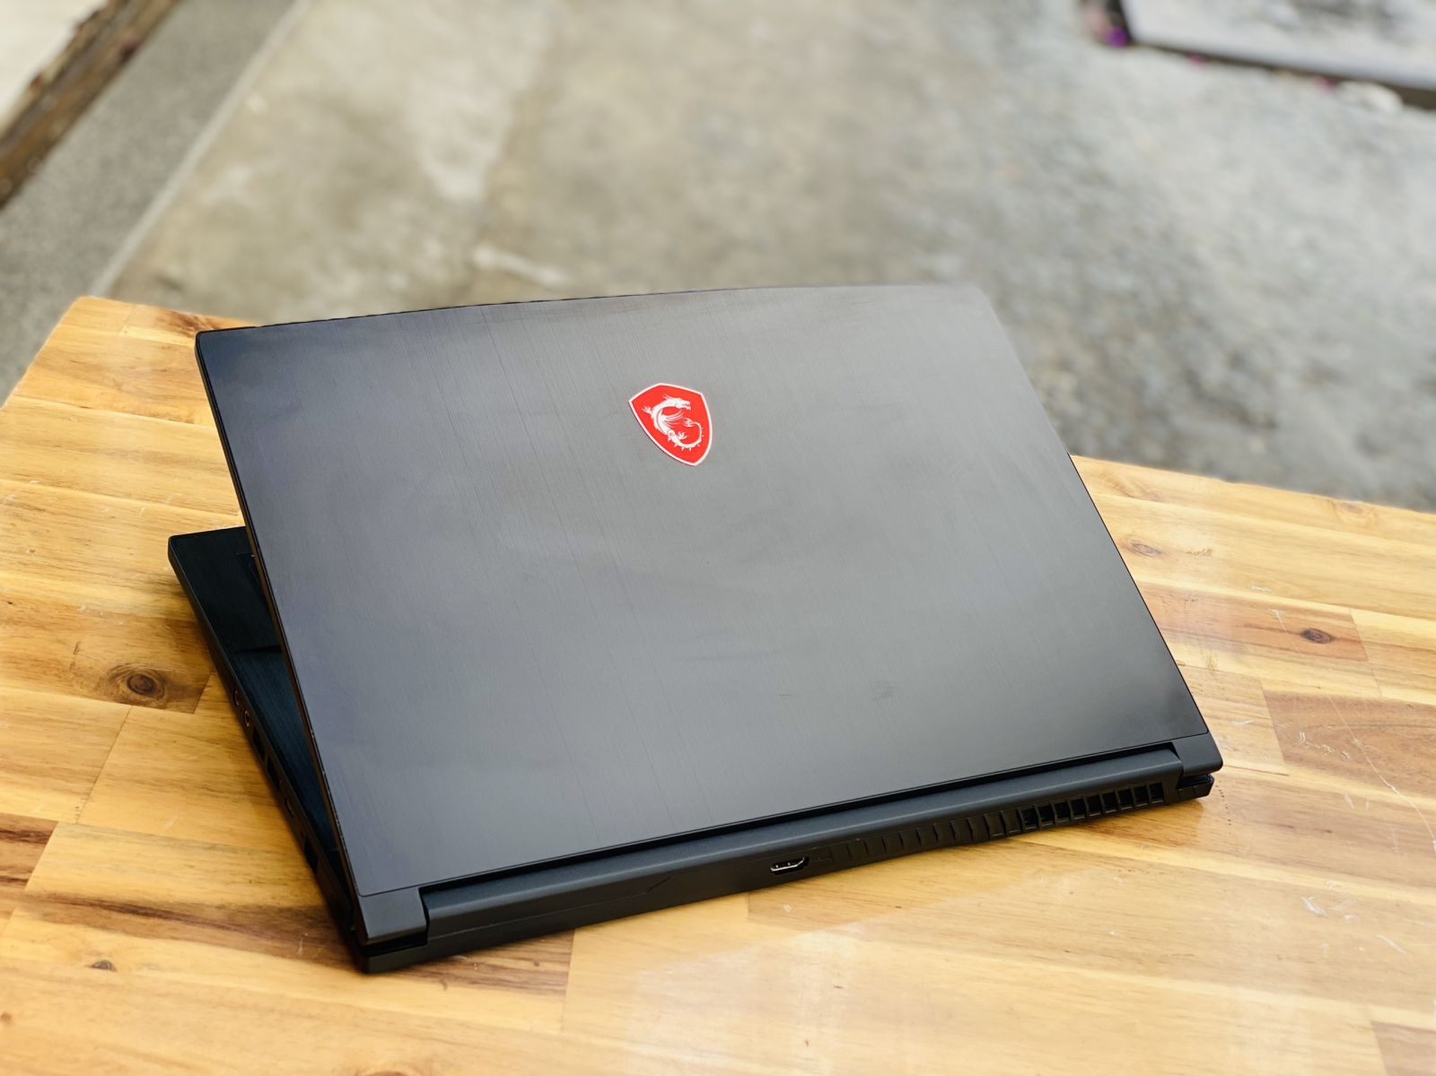
Contents of our presentation
A sleek black color
17-inch display
Aluminum and carbon fiber

Slide 4
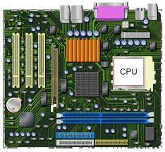
Contents of our presentation
01/
03/
03/
02/
Computer
introduction
Processor speed/hard drive capacity/memory size
Key components of a computer,function

Slide 5
01/
Computer introduction

Slide 6
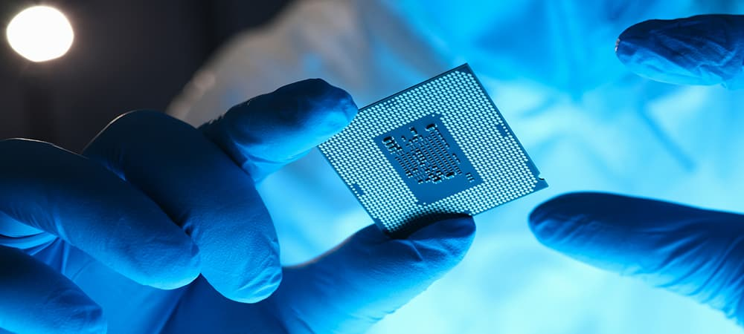

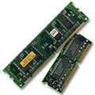
02/
Key components of a computer,function
CPU
RAM
Register

Slide 7
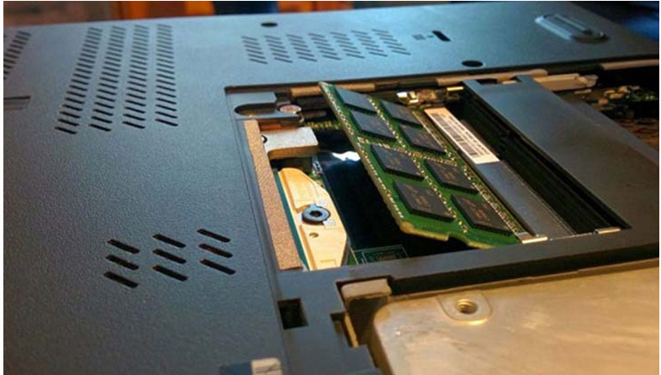
RAM
01
RAM stands for random access memory
02
A type of computer memory
03
called random access memory
- The execution time for each memory cell is the same
- Each memory in RAM has an address
- Each memory cell is 1 byte (8 bits).
04
RAM stores change information, operating information

Slide 8
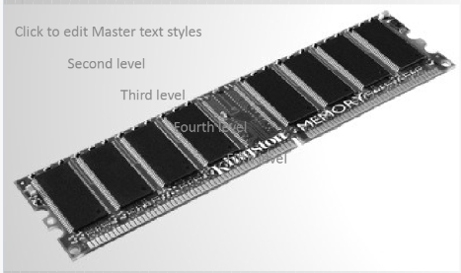
Functions of RAM
01
Computers use RAM to store program code and data during execution
02
The typical feature of RAM is that it allows for access to different memory locations with similar access times.

Slide 9
Register
Small, high-speed and direct memory built into the CPU
01
02
Store temporary values, acting as a buffer for data to be transferred between parts of the CPU
03
Helps increase CPU processing speed by reducing main memory,peripheral memory access times

Slide 10
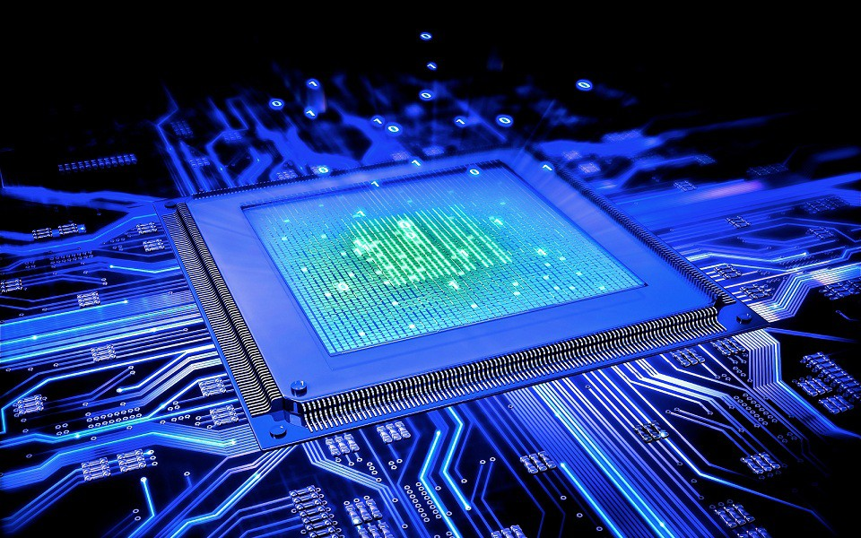
CPU
01
CPU(Central Processing Unit)
02
A CPU has three elements which are alu,register
and control units
03
-CU-Control-Unit
-ALU-Arithmetic Logic Unit
-RF-Registor Files

Slide 11
03/
Processor speed/hard drive capacity/memory size

Slide 12

Thanks!
Do you have any questions?

